Slide 1

Ratio Analysis in Python Functions
Python Programming | Built in function and user define function
Course: Python Programming | Chapter: Built in function and user define function | Bachelor of Computer Science and Engineering
DISCOVER · LEARN · EMPOWER
Notes:
Welcome everyone to this lecture on Ratio Analysis within the context of Python functions. We will explore how to calculate and interpret ratios using both built-in and user-defined functions. This session is designed to help you understand the practical application of mathematical ratios in programming.

Slide 2
Course Outcomes
SLIDE 2 / 14
Course Outcome
CO | BT LEVEL | DESCRIPTION
CO1 | BT1 | Understand the syntax, control structures, and basic constructs of Python programming language
CO2 | BT3 | Apply functions, modules, and exception handling for modular program development
CO3 | BT3 | Implement data structures including lists, tuples, dictionaries, and sets for efficient data processing
CO4 | BT4 | Analyze and manipulate files, strings, and perform data handling operations
CO5 | BT5 | Design and develop real-world applications integrating multiple Python concepts
Chandigarh University
2 / 14
Notes:
This lecture directly addresses CO3 by requiring you to implement data structures like lists to store ratio values. It also fulfills CO5 as you will design a function to calculate financial ratios for a real-world application. These outcomes ensure you can process data efficiently and build practical tools.

Slide 3
Learning Objectives
SLIDE 3 / 14
Learning Outcomes
1
Define ratio analysis as a method to compare two numerical values in Python.
2
Identify built-in functions like len() and sum() used in ratio calculations.
3
Create user-defined functions to encapsulate specific ratio logic.
4
Apply error handling to prevent division by zero errors in ratios.
5
Demonstrate the calculation of current ratio using sample financial data.
Chandigarh University
3 / 14
Notes:
By the end of this session, you will be able to define ratio analysis and identify the built-in functions that assist in calculations. You will learn to create your own functions to handle specific ratio logic safely. Finally, we will demonstrate a complete calculation of the current ratio using sample data.

Slide 4
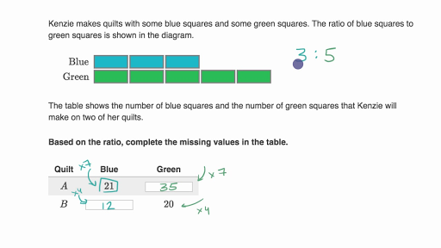
Lecture
SLIDE 4 / 14
Definition of Ratio Analysis
1
Ratio analysis compares two numbers to express their relative magnitude.
2
In Python, this involves dividing one variable by another variable.
3
The result is a dimensionless number representing a specific relationship.
4
It is fundamental for financial health checks and data normalization.
5
Python functions allow us to reuse this logic across datasets.
Ratios with tape diagrams
Chandigarh University
4 / 14
Notes:
Ratio analysis is simply comparing two numbers to see their relative size. In Python, we achieve this by dividing one variable by another. The result is a dimensionless number that tells us about the relationship between the values. This concept is crucial for financial health checks and normalizing data.

Slide 5
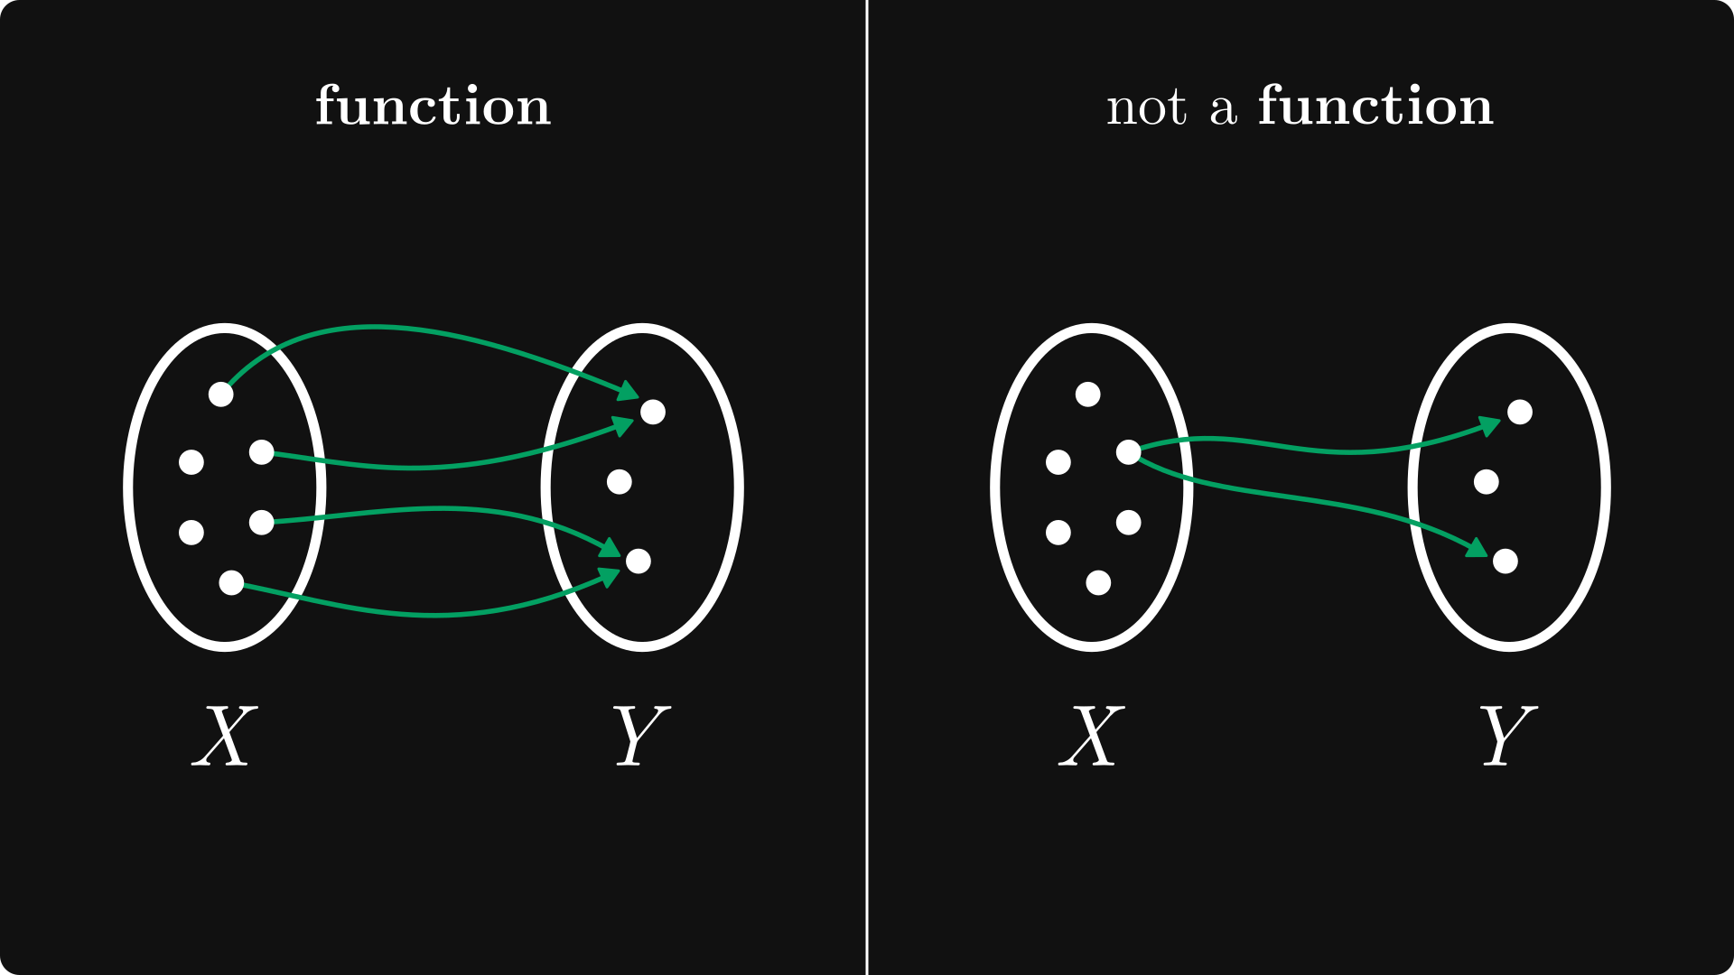
Lecture
SLIDE 5 / 14
Built-in Functions for Ratios
1
The len() function counts items to form a frequency ratio.
2
The sum() function aggregates values for total-to-part ratios.
3
The max() and min() functions help find range-based ratios.
4
These functions provide the raw data needed for calculation.
5
They are optimized for performance in large datasets.
Source: substackcdn.com
Chandigarh University
5 / 14
Notes:
Built-in functions like len() and sum() are essential for gathering the raw data needed for ratio calculations. The len() function counts items to form frequency ratios, while sum() aggregates values. These functions are optimized for performance, making them ideal for large datasets in real-world applications.

Slide 6
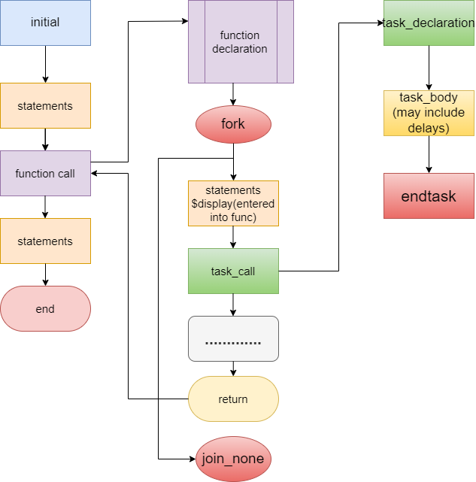
Lecture
SLIDE 6 / 14
User-Defined Functions for Ratios
1
User-defined functions encapsulate specific ratio calculation logic.
2
They accept parameters like numerator and denominator as inputs.
3
The function returns the calculated ratio value to the caller.
4
This promotes code reusability and modular programming practices.
5
Naming conventions should clearly indicate the ratio being calculated.
Source: user-images.githubusercontent.com
Chandigarh University
6 / 14
Notes:
User-defined functions allow us to encapsulate specific ratio calculation logic into reusable blocks. They accept parameters like the numerator and denominator as inputs and return the calculated ratio. This promotes code reusability and modular programming, which is a key skill in Python development.

Slide 7
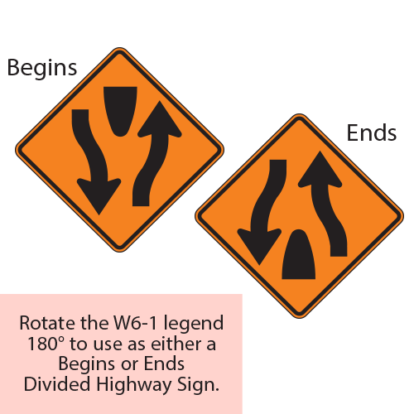
Lecture
SLIDE 7 / 14
Handling Division by Zero
1
Division by zero causes a ZeroDivisionError in Python.
2
Always check if the denominator is non-zero before dividing.
3
Use conditional statements to handle invalid ratio inputs gracefully.
4
Return a specific value or message when the denominator is zero.
5
This prevents the program from crashing during execution.
Source: cdn11.bigcommerce.com
Chandigarh University
7 / 14
Notes:
A common pitfall in ratio analysis is division by zero, which causes a ZeroDivisionError in Python. You must always check if the denominator is non-zero before performing the division. Using conditional statements allows you to handle invalid inputs gracefully and prevents the program from crashing.

Slide 8
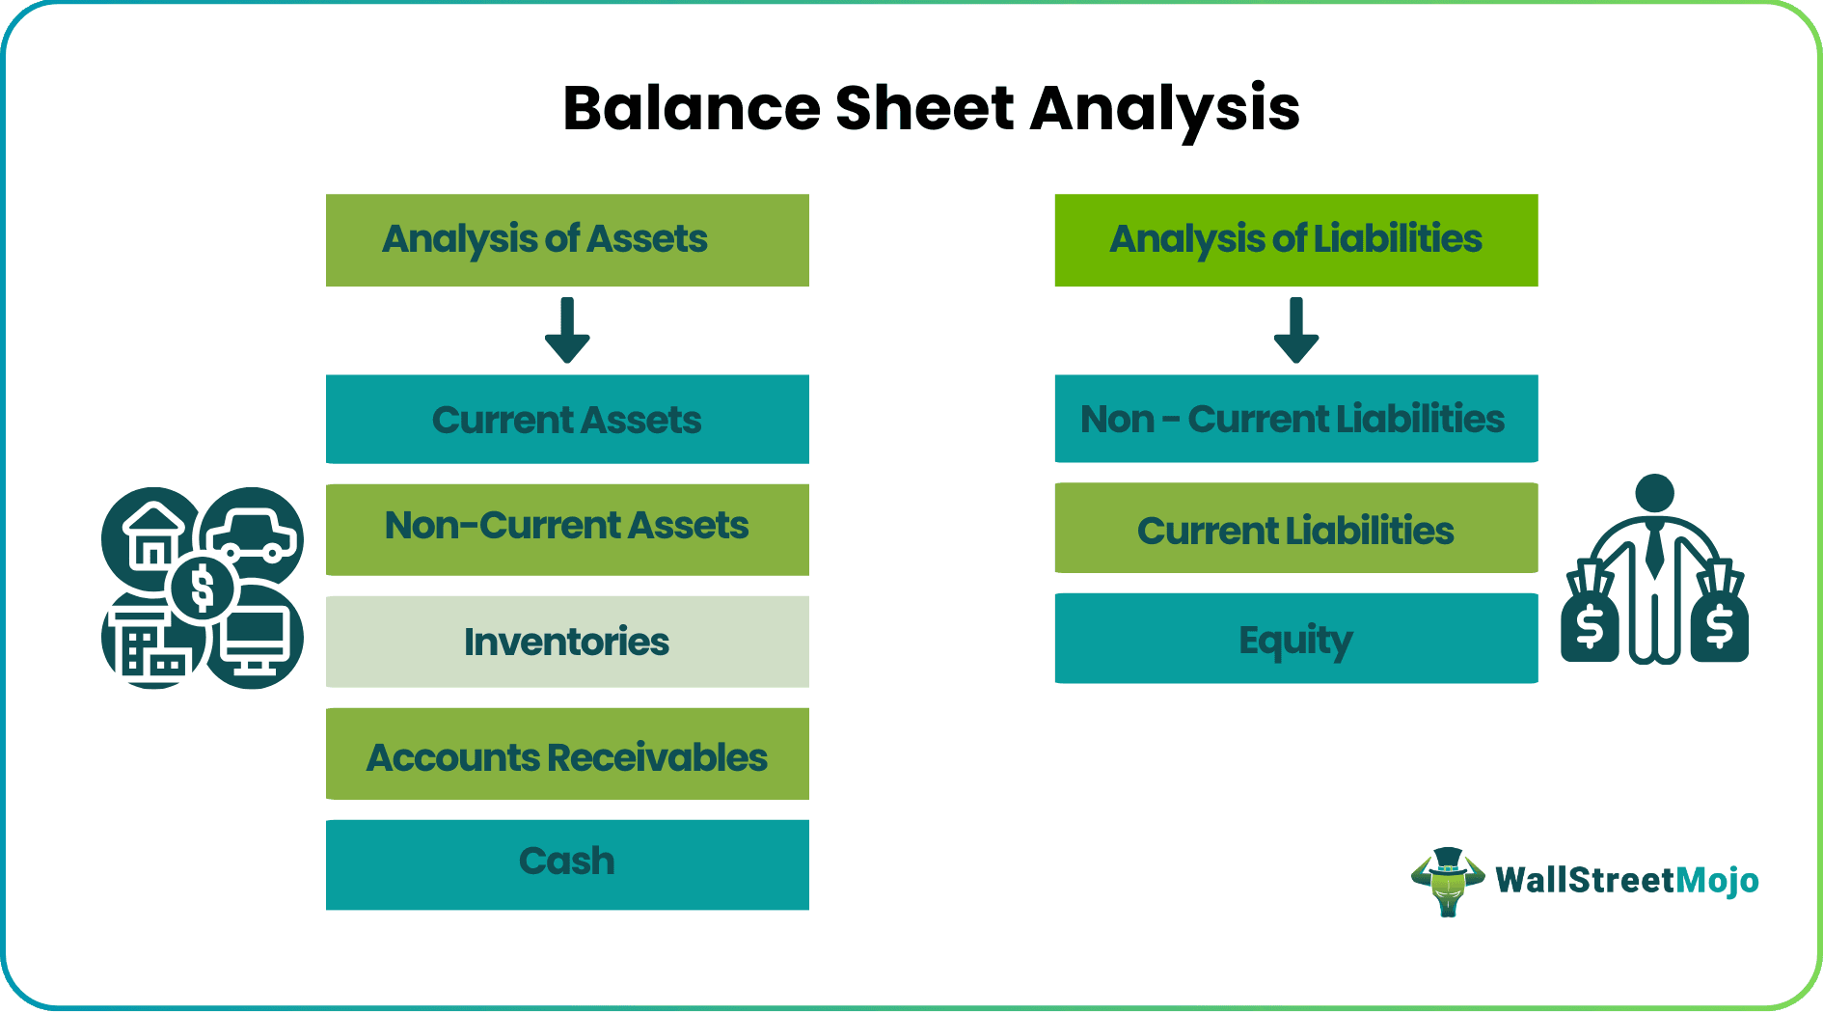
Worked Example
SLIDE 8 / 14
Current Ratio
GOVERNING EQUATION
Current Ratio = Current Assets / Current Liabilities
EXAMPLE
Assets = 50000, Liabilities = 25000.
CALCULATION
50000 / 25000 = 2.0.
• A ratio of 2.0 indicates strong liquidity position.
• This example uses a user-defined function for calculation.
Source: wallstreetmojocms.recurpro.in
Chandigarh University
8 / 14
Notes:
Let's look at a worked example of the Current Ratio. If Current Assets are 50000 and Liabilities are 25000, the calculation is 50000 divided by 25000. This results in a ratio of 2.0, indicating a strong liquidity position. We will implement this logic using a user-defined function in our code.

Slide 9
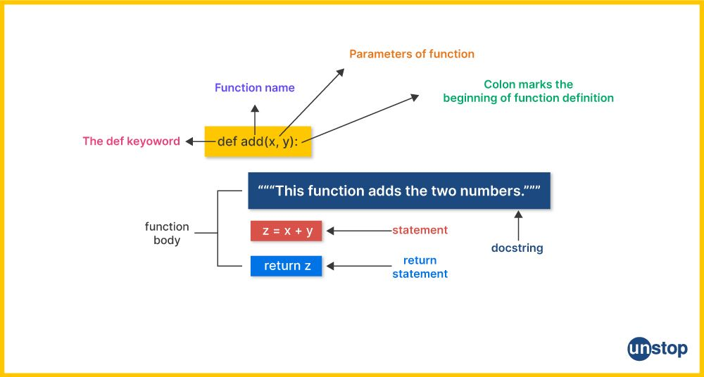
Worked Example
SLIDE 9 / 14
Code Logic
1
Define function calculate_ratio(numerator, denominator).
2
Check if denominator equals zero using an if statement.
3
Return numerator divided by denominator if valid.
4
Return 'Undefined' if the denominator is zero.
5
Call the function with sample values to test output.
Source: d8it4huxumps7.cloudfront.net
Chandigarh University
9 / 14
Notes:
In our code, we define a function called calculate_ratio that takes two parameters. We check if the denominator is zero using an if statement to ensure safety. If valid, we return the division result; otherwise, we return 'Undefined'. This logic ensures our program handles all input scenarios correctly.

Slide 10

Lecture
SLIDE 10 / 14
Common Pitfalls in Ratios
1
Ignoring integer division results in loss of precision.
2
Using floating-point numbers can introduce rounding errors.
3
Failing to validate input data leads to incorrect ratios.
4
Hardcoding values instead of using variables reduces flexibility.
5
Not handling exceptions causes unexpected program termination.
Source: static.vecteezy.com
Chandigarh University
10 / 14
Notes:
There are several common pitfalls when working with ratios in Python. Ignoring integer division can lead to a loss of precision, while floating-point numbers might introduce rounding errors. It is crucial to validate input data and avoid hardcoding values to ensure your code remains flexible and robust.

Slide 11
Lecture
SLIDE 11 / 14
Data Structures for Ratios
1
Lists store multiple ratio values for batch processing.
2
Dictionaries map ratio names to their calculated values.
3
Tuples provide immutable storage for fixed ratio constants.
4
Sets can be used to find unique ratio values efficiently.
5
Choosing the right structure depends on the data usage.
Chandigarh University
11 / 14
Notes:
Data structures play a vital role in managing ratio data efficiently. Lists are useful for storing multiple ratio values for batch processing, while dictionaries map ratio names to their calculated values. Tuples and sets offer immutable storage and efficient unique value handling, respectively, depending on your specific needs.

Slide 12
Lecture
SLIDE 12 / 14
Real-World Application Context
1
Financial analysis uses ratios to assess company health.
2
Engineering uses ratios to compare efficiency and performance.
3
Python functions automate these calculations for large datasets.
4
Integration with data structures allows for complex reporting.
5
This approach supports decision-making in various industries.
Chandigarh University
12 / 14
Notes:
Ratio analysis has real-world applications in financial analysis and engineering. Python functions automate these calculations, making it possible to process large datasets efficiently. By integrating these functions with data structures, we can support complex reporting and decision-making processes in various industries.

Slide 13
Lecture
SLIDE 13 / 14
Key Takeaways
1
Ratio analysis compares two values using division in Python.
2
Built-in functions provide the data needed for calculations.
3
User-defined functions encapsulate logic for reusability and safety.
4
Always handle division by zero to prevent crashes.
5
Data structures like lists and dictionaries manage ratio data.
Chandigarh University
13 / 14
Notes:
To summarize, ratio analysis involves comparing two values using division. Built-in functions provide the necessary data, while user-defined functions encapsulate the logic for reusability. Always remember to handle division by zero to prevent crashes, and use appropriate data structures to manage your ratio data effectively.

Slide 14
Lecture
SLIDE 14 / 14
References
PYTHON
A Practical Learning Approach, 1st Edition — T.S. Murugesh, Shriram K. Vasudevan, Sini Raj Pulari
• Learning Python, 6th Edition — Mark Lutz
• Starting Out with Python, Global Edition, 6th Edition — Tony Gaddis
• Introduction to Python Programming and Data Structures, 3rd Edition — Y. Daniel Liang
Chandigarh University
14 / 14
Notes:
For further reading, please refer to the textbooks listed on this slide. These resources provide comprehensive coverage of Python programming and data structures. They will help you deepen your understanding of the concepts discussed in this lecture.

